Slide 1

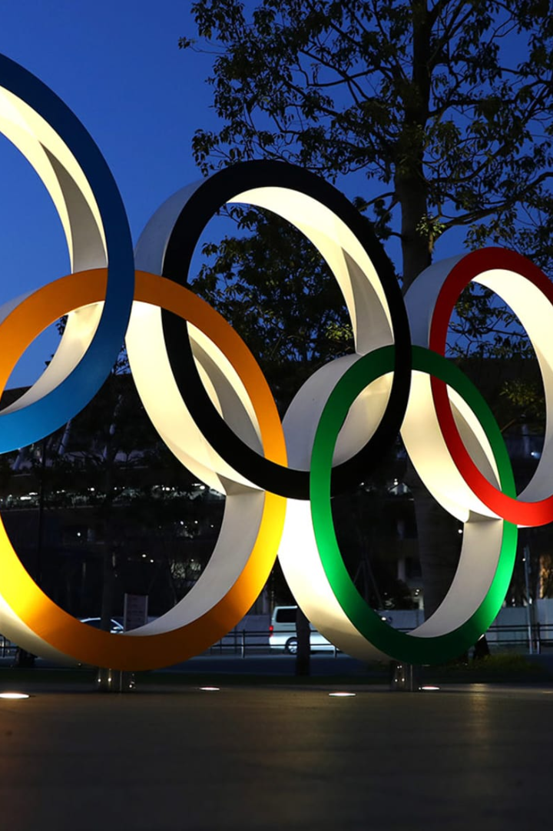

Olympic Data Analysis with Azure
A Data Engineering Showcase
by Sanjay Kumar

Slide 2

Project Overview
The project demonstrates the power of data engineering with Azure services. It involves collecting data from Kaggle and GitHub, setting up Azure Data Factory for seamless data movement, leveraging Azure Databricks for data transformation, and analyzing the data using Azure Synapse Analytics.

Slide 3
Data Engineering Steps
1
Data Collection
Gather relevant data from Kaggle and GitHub.
2
Data Movement
Use Azure Data Factory to transfer data between sources.
3
Data Transformation
Utilize Azure Databricks to clean and preprocess the data.
4
Data Analysis
Perform advanced analytics with Azure Synapse Analytics.

Slide 4

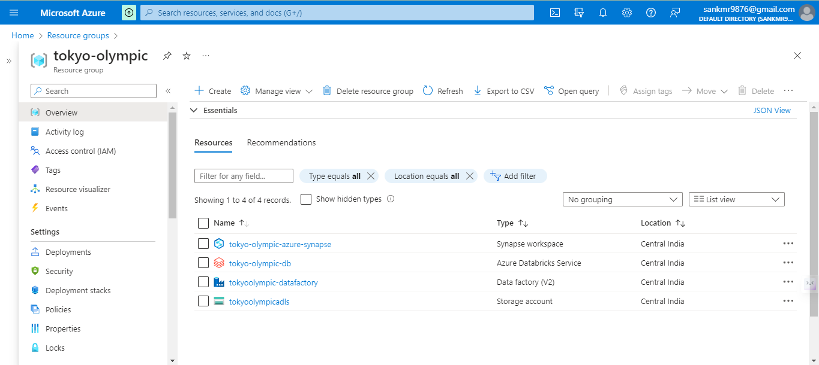

Slide 5
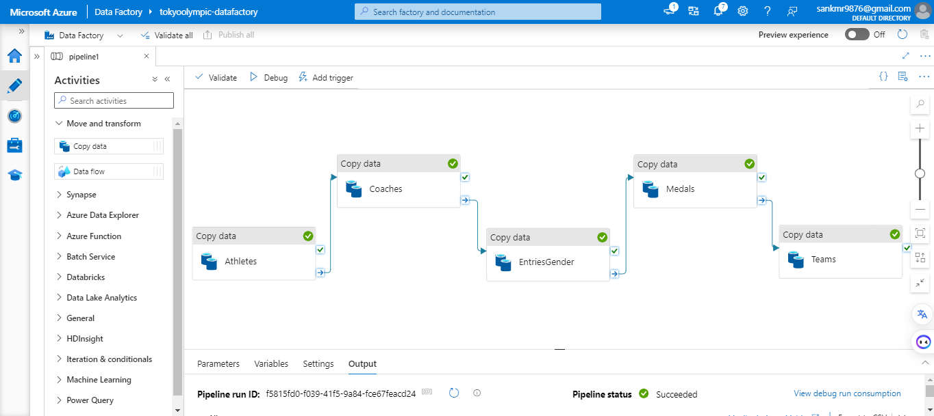

Slide 6
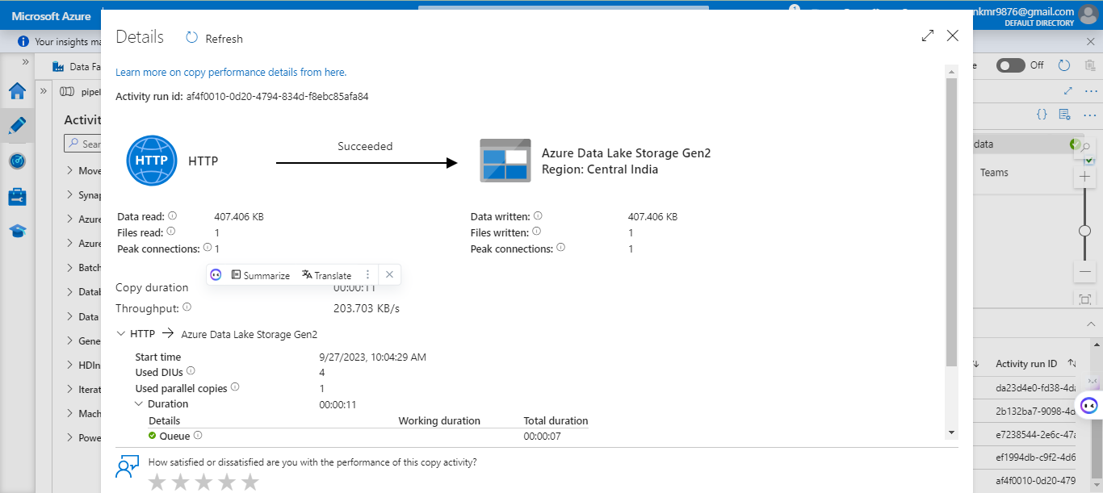

Slide 7
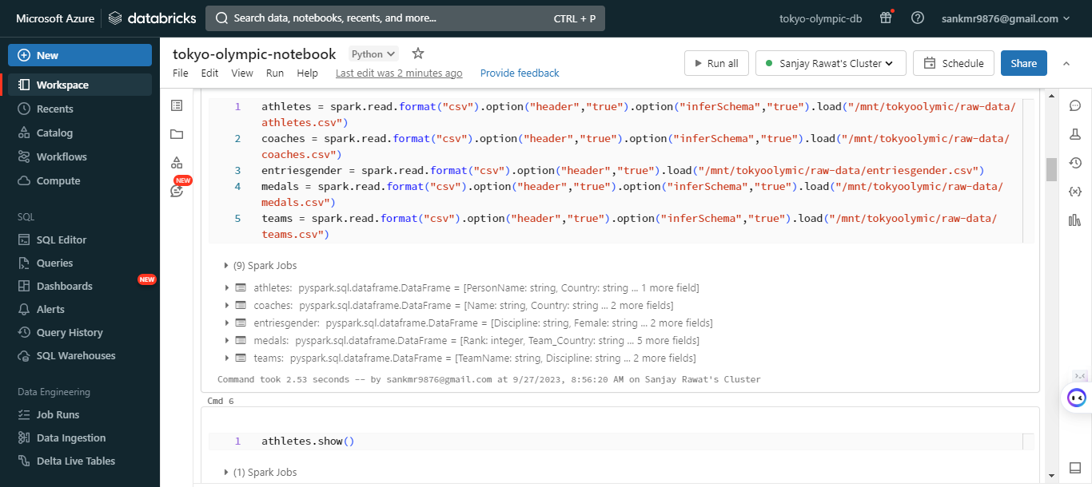

Slide 8
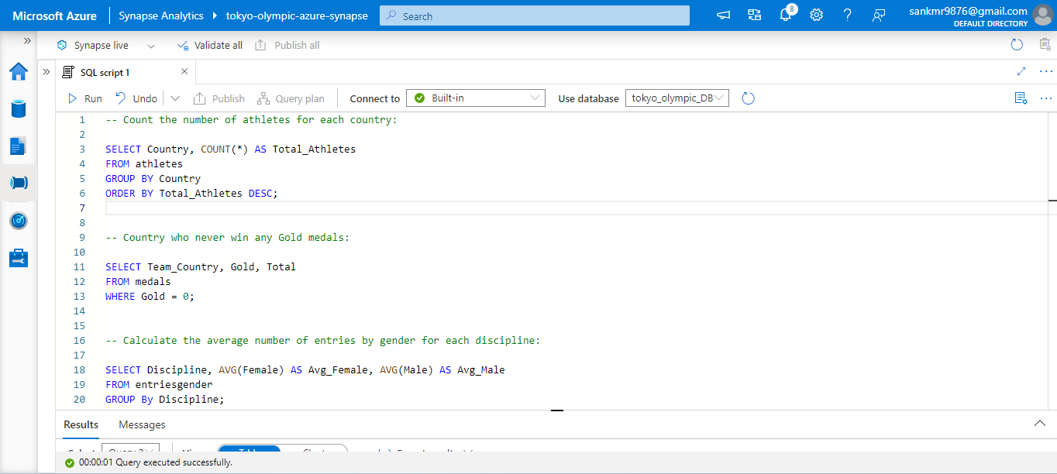

Slide 9

Data Analysis Insights
Uncover valuable insights from Olympic data using the robust features of Azure Synapse Analytics. Discover patterns, trends, and correlations that provide key insights into the world of sports, athlete performance, and beyond.

Slide 10
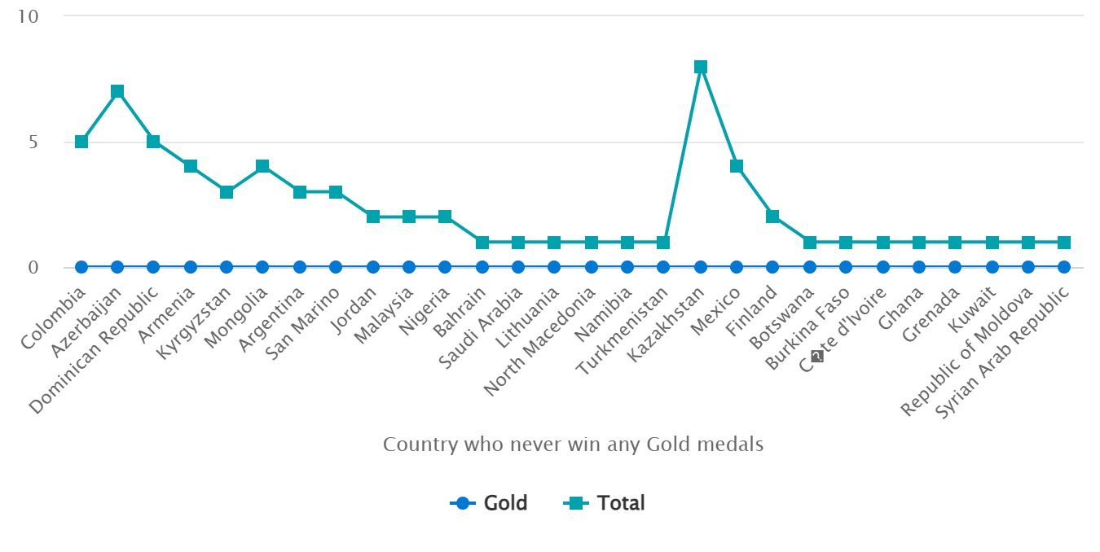

Slide 11
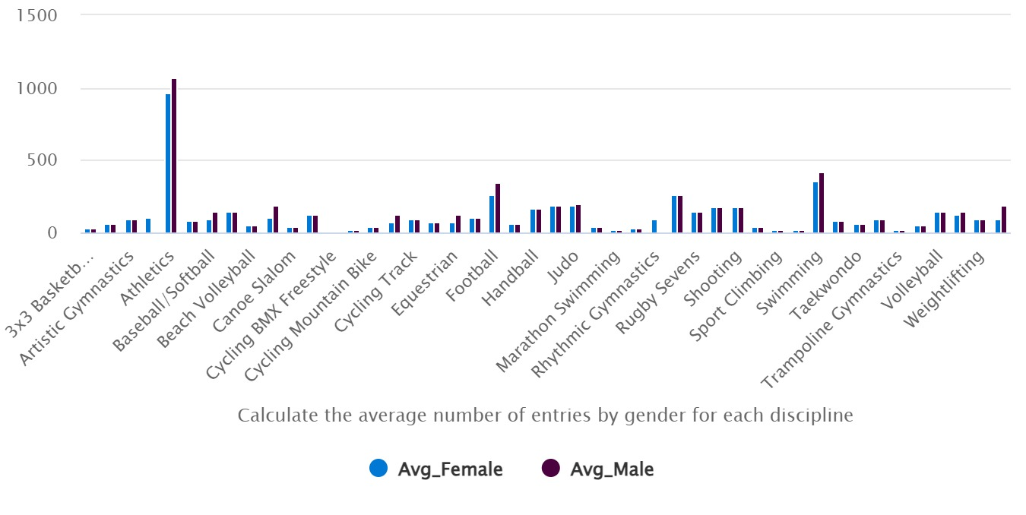

Slide 12
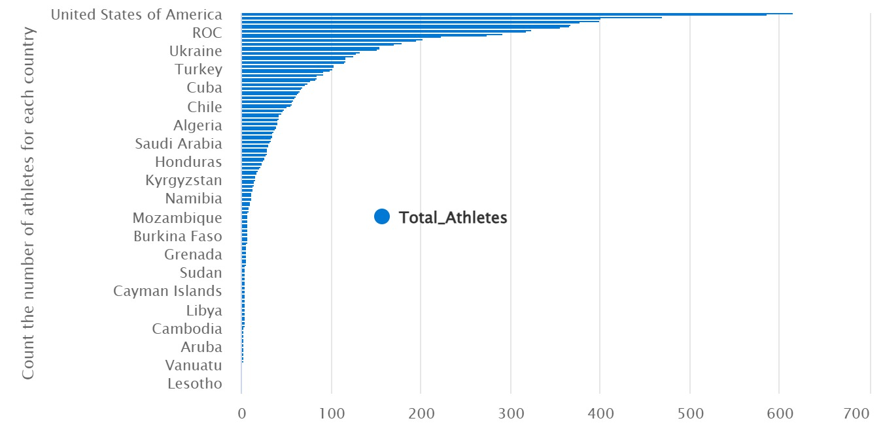

Slide 13
Contact & Thank You
For any inquiries or further information, please feel free to contact us at [Sanjaykmrjnv@gmail.com] We would like to express our gratitude for your attention and participation in this presentation.
Project Link: https://github.com/Sanjaykmrjnv/tokyo-olympic-azure-data-engineering-project.git

